Slide 1
EMPLOYEE SALARY PREDICTION CAPSTONE PROJECT
NAME – Soumyadip samanta
COLLEGE NAME – university institute of technology, The university of burdwan
DEPARTMENT – Information technology

Slide 2
OUTLINE :-
Problem Statement
Proposed System/Solution
System Development Approach (Technology Used)
Algorithm & Deployment
Result (Output Image)
Conclusion
Future Scope
References

Slide 3
PROBLEM STATEMENT :-
In the corporate environment, salary prediction is a crucial task for HR and finance departments.Predicting salaries based on experience, education, job role, location, and industry standards is complex.Manual estimations can lead to unfair wages and dissatisfaction among employees.

Slide 4
PROPOSED SOLUTION :-
Develop a machine learning-based model to predict employee salaries.
Steps:-
Collect employee data (experience, education, role, location, industry).
Preprocess and clean the data.
Use regression algorithms (e.g., Random Forest) for prediction.
Build an interactive UI for salary input and prediction.
Evaluate the model using performance metrics (MAE, RMSE, R² Score).

Slide 5
SYSTEM APPROACH :-
System Requirements:-
Python 3.9+, Jupyter/VS Code, scikit-learn, pandas, matplotlib.
Required Libraries:-
pandas – data handling
numpy – numerical operations
matplotlib / seaborn – visualization
scikit-learn – machine learning algorithms
joblib – model persistence

Slide 6
ALGORITHM & DEPLOYMENT :-
Algorithm:
Random Forest Regressor – handles nonlinear data, avoids overfitting.
Input Features:
Experience, Education, Role, Location, Industry.
Training:
Train/test split
Cross-validation
Hyperparameter tuning
Prediction:
Model outputs salary based on user input.
Deployment:
Web interface using Flask or Streamlit.

Slide 7
RESULT :-
Results show high accuracy in salary prediction.
Visuals:
Predicted vs Actual Salary graphs
Metrics:
R² Score
Mean Absolute Error (MAE)
Root Mean Squared Error (RMSE)

Slide 8
CONCLUSION:-
The ML model predicts salaries accurately and helps in fair compensation decisions.
Useful for HR and finance departments.
Challenges:- Data quality, feature selection.
Improvements:- Possible with more data and better tuning.

Slide 9
FUTURE SCOPE :-
Use real-time salary trends via API integration.
Extend model to support global salary predictions.
Use deep learning for better results.
Integrate. with HR management systems

Slide 10
REFERENCES:-
Kaggle -
Salary Prediction Datasets
Scikit-
learn Documentation
Hands-
On ML with Scikit-Learn by Aurélien Géron
IBM AI Engineering Specialization – Coursera

Slide 11
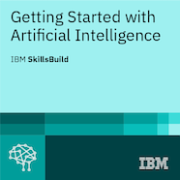
SCREANSHOTS OF OUR PROECTS
Getting started with AI

Slide 12
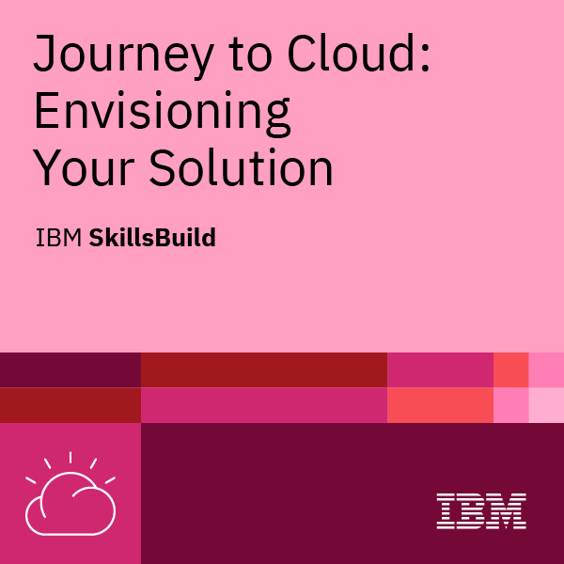
Journey to Cloud

Slide 13
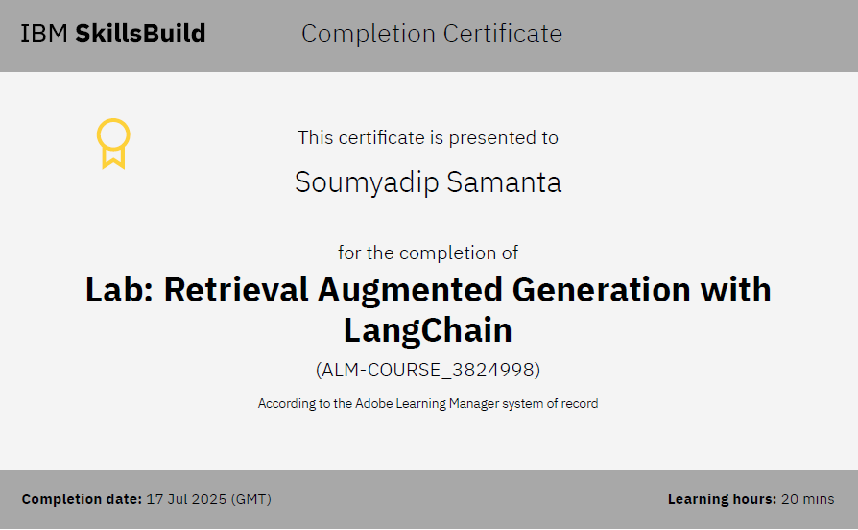
RAG Lab

Slide 14
THANK YOU

